Slide 1
The Fiscal Status and Outlook for Local Governments in Michigan and Branch County
Dr. Eric Scorsone, Co-Director
State and Local Government Program, Michigan State University Extension Service

Slide 2
The Economics of Local Governments in Michigan

Slide 3
Government Employees
Michigan ranks #11 for number of local government employees
351,779 local government employees
  This includes school districts

Slide 4
Local Government Employees per Residents
Police Protection
  18.6 police officers per 10,000 residents in MI
  National average is 22.9 per 10,000
Fire Protection
  6.9 firefighters per 10,000 in MI
  National average is 10.9 per 10,000
Water/Sewer
  4.0 employees per 10,000
  National average is 4.3 per 10,000
Total
  Mi has 482 employees per 10,000
  National average is 538 employees per 10,000

Slide 5
Local Govt. Spending Per capita
Police Protection
  MI: $196 per capita; USA: $223 per capita
Fire Protection
  MI:$67 per capita; USA: $90 per capita
Parks and Recreation
  MI: $105 per capita; USA: $104 per capita
Housing and Community Development
  MI: $37; USA: $109 per capita

Slide 6
Local Government Spending: Are We Spending Too Much?
Illinois | $1,251.00
Michigan | $1,150.23
Pennsylvania | $1,059.93
Indiana | $1,286.79
Ohio | $1,342.88
Wisconsin | $1,127.64
Spending own source per capita

Slide 7
Fiscal Health of Local Governments in Michigan

Slide 8
MI Local Government Fiscal Stress
The Basic Problem:
Expenditures
Revenues
Structural limitations in property tax collection
Decreasing intergovernmental aid
Heath Care
Pensions
Homeland Security
Statewide, we are projecting a 2-3% structural deficit for local governments

Slide 9
Fiscal Stress
Stress varies across types of governments
Urban cities and townships have seen more stress
Good News
  Governments have managed to keep balance sheets on track
  But often at expense of service reductions

Slide 10
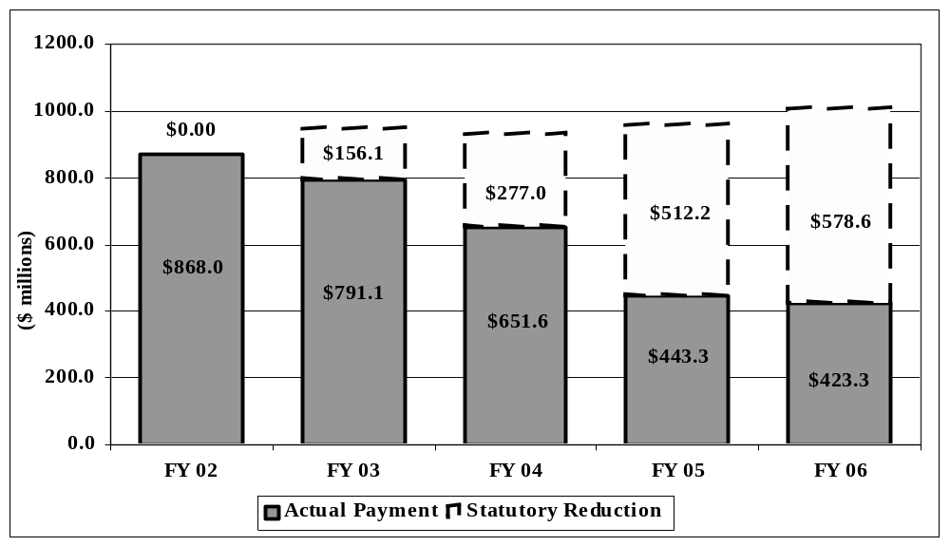
Fiscal Stress: Revenue Sharing

Slide 11
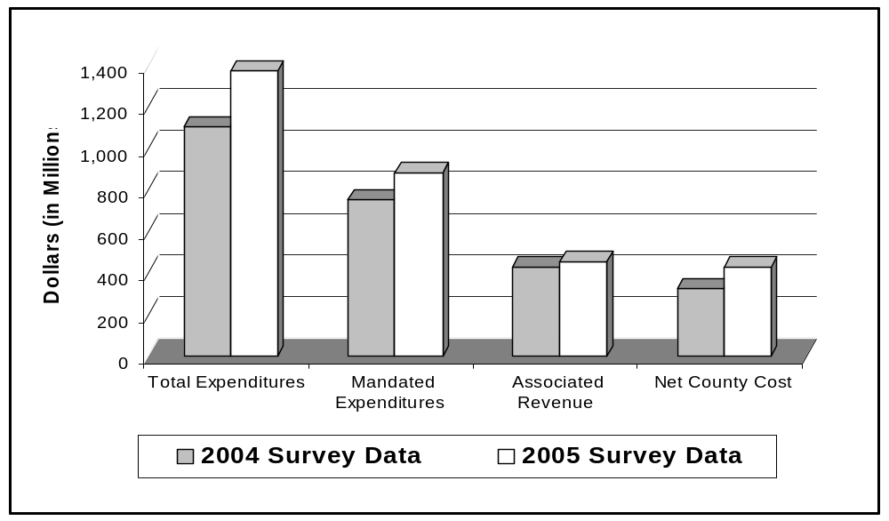
Fiscal Stress: State and Federal Mandates
County Government and Total Mandated Costs

Slide 12
Townships
 | Average | Standard Deviation | Median
Current Ratio | 118.20 | 208.37 | 18.10
Net assets/Expenses | 1.05 | 0.64 | 0.88
Net assets/Revenues | 0.99 | 1.60 | 1.10
Financial Position | 1.05 | 0.64 | 0.88
Leverage | 0.10 | 0.87 | 0.05
Tax Leverage | 1.73 | 3.95 | 1.89

Slide 13
Cities
 | Average | Standard Deviation | Median
Current Ratio | 10.47 | 17.24 | 5.93
Net Assets/Expenses | 0.57 | 0.44 | 0.44
Net Assets/Revenues | 0.75 | 0.63 | 0.64
Financial Position | 0.57 | 0.44 | 0.44
Leverage | 0.40 | 0.26 | 0.38
Tax Leverage | 2.05 | 23.98 | 3.64

Slide 14
Fiscal Scoring Table
0 | 13% scored in this category |  | 88% Fiscally Neutral
1 | 22% scored in this category
2 | 22% scored in this category
3 | 19% scored in this category
4 | 12% scored in this category
5 | 7% scored in this category |  | 11% Watch List
6 | 2% scored in this category
7 | 2% scored in this category
8 | 1% scored in this category |  | 1% Fiscal Stress

Slide 15
Municipalities Fiscal Score
City of Coldwater: 4
Good Points
  No other fund deficits
  Strong fund balance
  Lowe debt
  No major declines in taxable value
Potential problems
  Population loss from 2000 through 2006
  GF operating deficit (fairly small)

Slide 16
County Fiscal Score
Branch County: 3
Good Points
  Population gain
  No major loss in taxable value
  No other fund deficits
  Strong fund balance
Potential problems
  GF deficit

Slide 17
Options for Fiscal Stress
Long Term
  Economic Development & Diversification
  Investments in Education and People (labor force)
Short Term
  Tax Increase
  Intergovernmental Cooperation & Consolidation
  Cut Spending
  Use Reserves or stabilization funds

Slide 18
Public Private Interaction
Goal of government cooperation is to save money and maintain or improve services
Public Sector
Public Expenditures and services
Taxes
Private Sector

Slide 19
Option 1: Tax Base and Increases

Slide 20
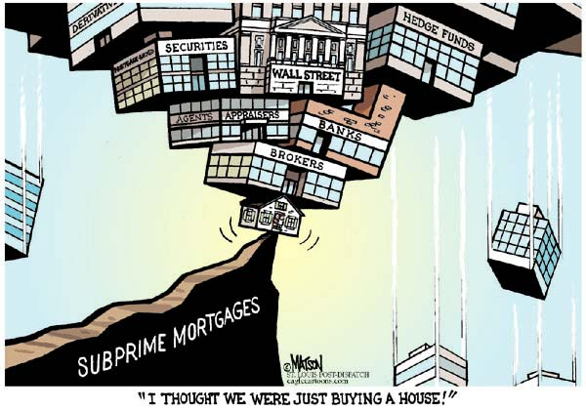

Slide 21
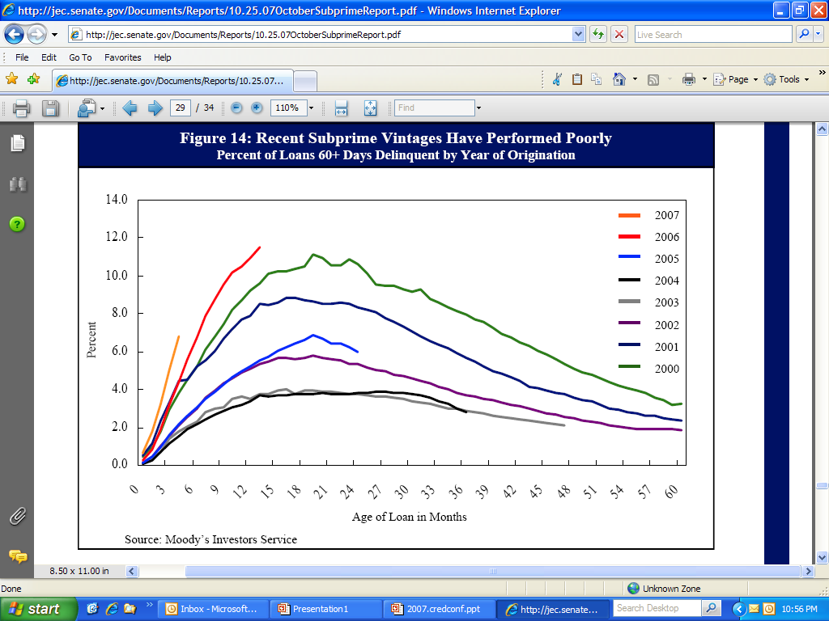

Slide 22
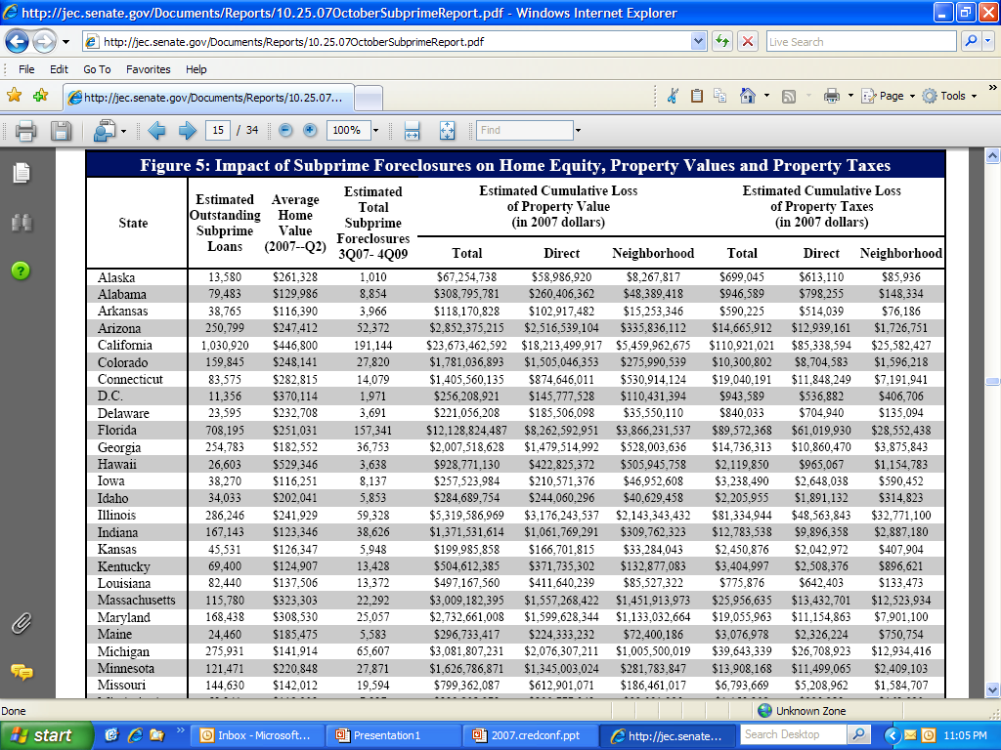

Slide 23
TV/SEV by Property Type (2007)
 | State Equalized | Taxable
CLASSIFICATION | Valuation | Valuation | TV/SEV
Agricultural | $17,653,875,255 | $8,709,496,551 | 0.49
Commercial | $61,995,642,365 | $49,075,109,720 | 0.79
Industrial | $25,813,944,008 | $22,193,254,919 | 0.86
Residential | $317,605,998,910 | $248,796,215,888 | 0.78
Timber Cutover | $366,013,213 | $136,835,369 | 0.37
Developmental | $648,117,644 | $296,043,443 | 0.46

Slide 24
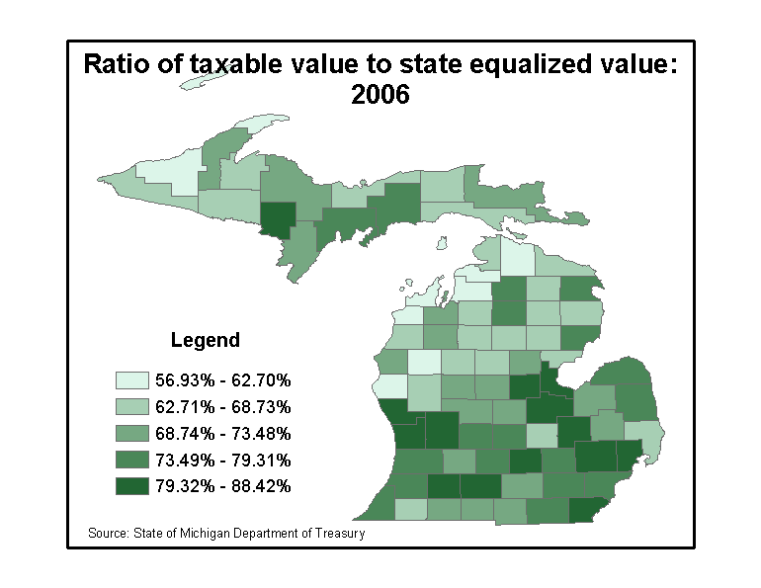
TV/SEV

Slide 25
Revenue Loss Factors
The assessment growth limit insulates local units of government from more severe losses. But revenue loss potential still exists, especially for some counties:
  A lot of recently built homes and recently sold homes
  Residential property value is a high percentage of total property value
  A lot of low to moderately priced homes
  Foreclosed properties may have a delay in property tax payments.

Slide 26
Factors That Insulate Counties from Potential Revenue Loss
Assessment Growth Limit Can Serve to Insulate.
  To see this, we must review how the assessment growth limit works
    Taxable value < state equalized value
    Recently sold homes are a key
Areas with Relatively Strong Industrial/Commercial and Agriculture Sectors are Insulated, to Some Degree

Slide 27
The Silver Lining
The negative impacts of the foreclosure crises are being felt nationwide, and certainly local governments are not immune
BUT there are some positives
  As housing prices fall, housing becomes more affordable
    Potential new homeowners benefit
      More home for less
      Extra $ to spend elsewhere
  Recently, interest rates had been falling. But inflationary pressures are pushing rates back up.

Slide 28
Local Tax Related Ballot Issues
Tax increases or Headlee overrides
CY 2006
  County
    26 issued, 9 approvals (34.6%)
  City/Village
    25 issued, 14 approvals (56%)
  Townships
    114 issued, 35 approvals (30.7%)

Slide 29
Intergovernmental Cooperation and Consolidation

Slide 30
Number of locals in USA
Counties 3,034
Municipalities 19,431
Towns & Townships 16,506
School Districts 13,522
Special Districts 35,356
Total: 87,849

Slide 31
States with the Largest Number of
Local Governments
State
# of Governments
Rank
Illinois | 6,835 | 1
Pennsylvania | 5,070 | 2
Texas | 4,700 | 3
California | 4,607 | 4
Kansas | 3,950 | 5
Ohio | 3,597 | 6
Minnesota | 3,501 | 7
Missouri | 3,416 | 8
New York | 3,413 | 9
Indiana | 3,198 | 10
Michigan is ranked #14

Slide 32
Number of Local Government in Michigan by Type
Types of units in 2002 | # of Units
Government
City/Village | 533
County | 83
Township | 1,242
Special Districts | 366
Total | 1,858

Slide 33
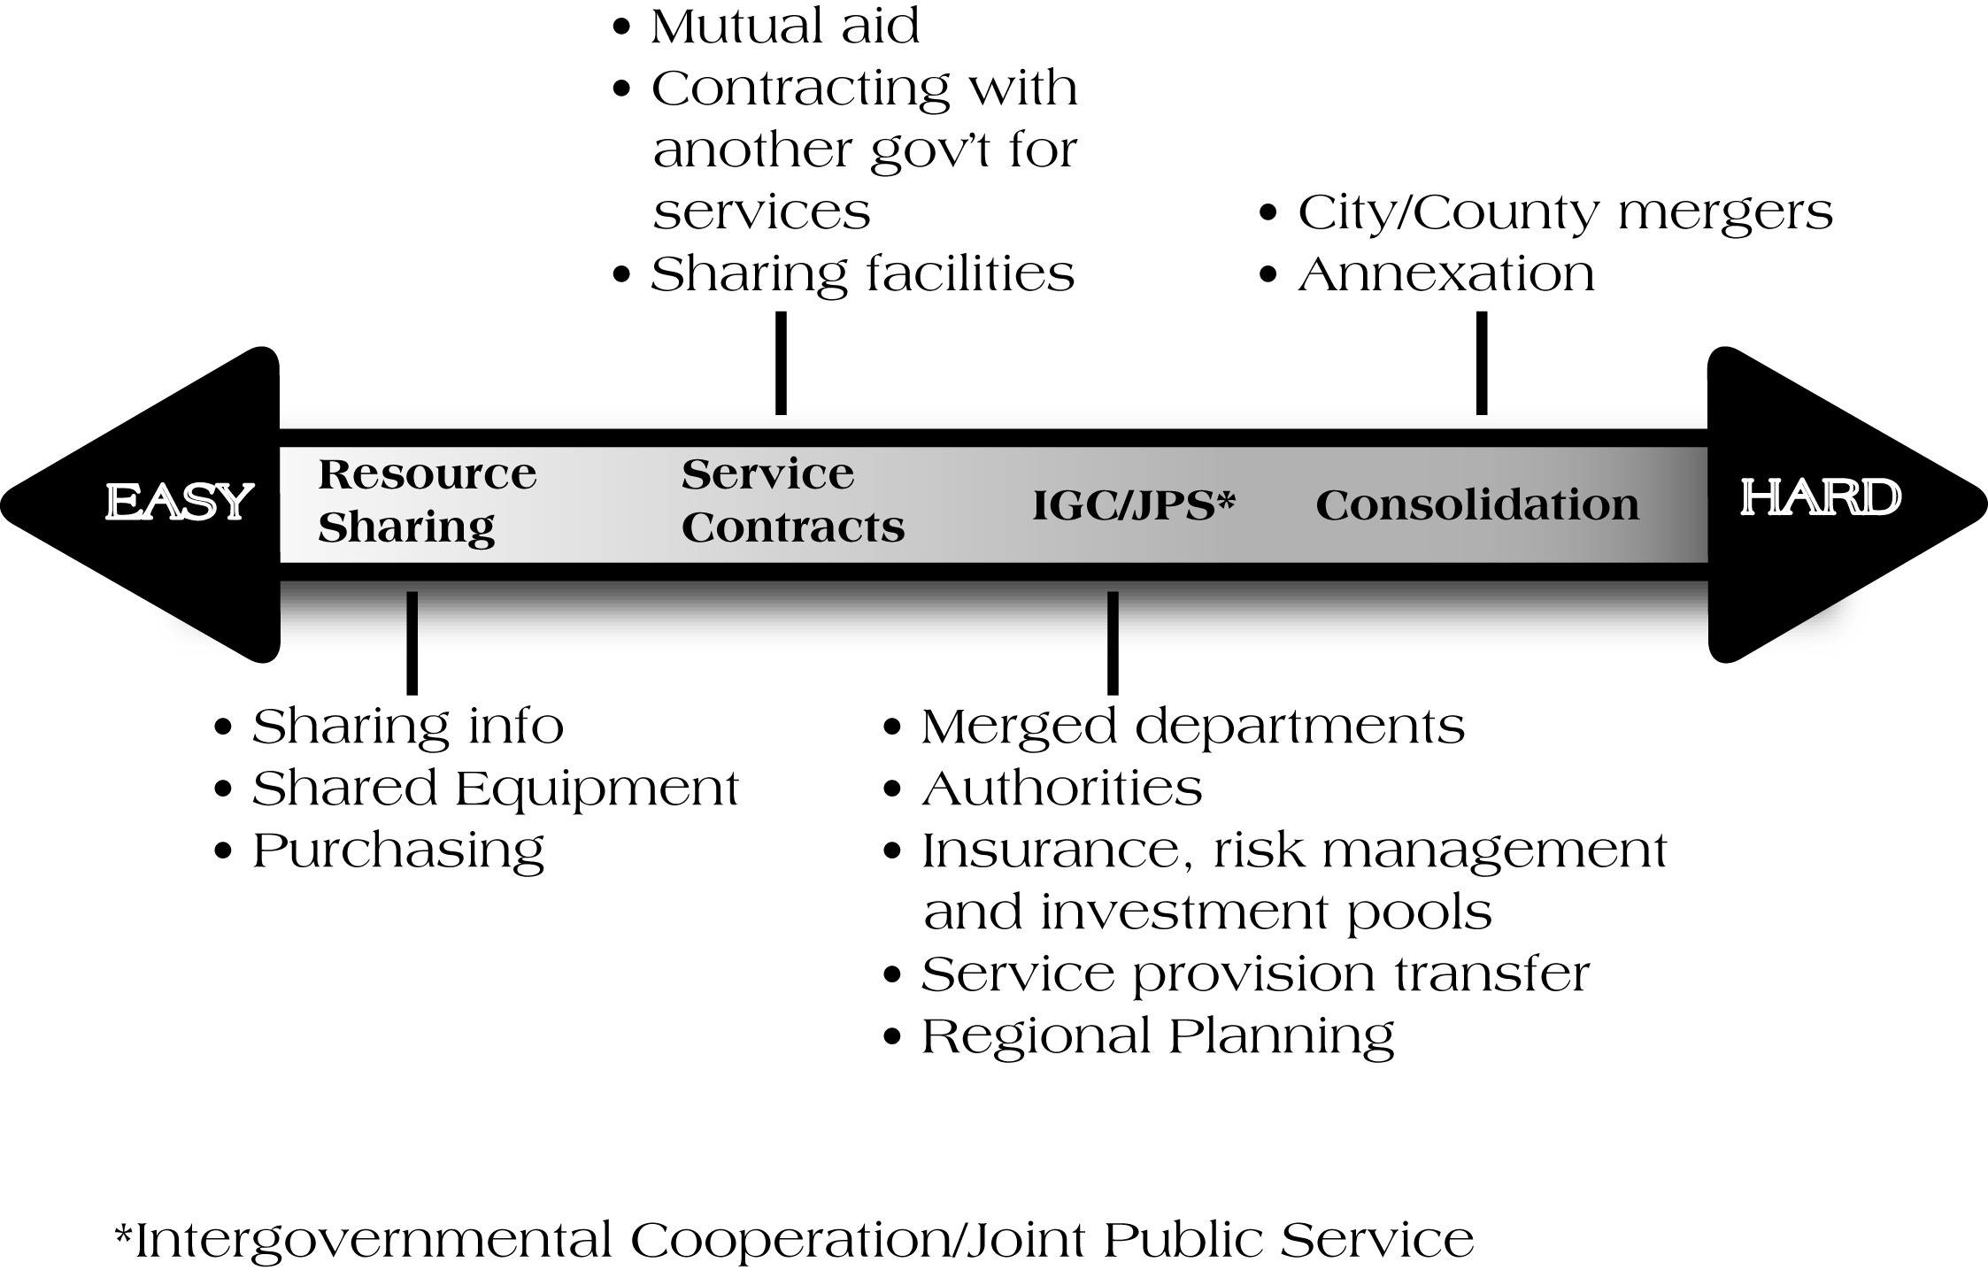
Collaboration Continuum

Slide 34
Local Governments are cooperating, more could be done…
Treasury and Tax Collection 88% provide themselves
Vehicle Maintenance: 43% in-house; 30% private producer
Fire Fighting: 53% in-house; 10% contract with municipality; 10% through special district

Slide 35
Cooperation—Areas of Opportunity
Police
  Evidence does not point to major cost savings; labor intensive
Fire/EMS
  Evidence does point to cost savings
  15% possible estimated cost savings ($100 mil.) from cooperation within 5-7 yrs.
Economic Development
  Very little scientific research produced to date

Slide 36
Cooperation—Areas of Opportunity
Planning and Zoning
  No obvious major cost savings
Transportation and Roads
  In rural roads, but MI already has MI has already undertaken this process
Property Assessment
  Research underway; some may exist but not a major cost center
Internal Services
  No real research, but business process model may make the case for cost savings

Slide 37
Political Consolidation/Merger
Past 30 years of research does not point to success in achieving projected cost savings
Feasibility studies are just that feasible, not actual results
Limited success may be achievable:
  Rural communities
  Densely packed urban areas such as Detroit

Slide 38
Consolidation: Case in Point
Newly Consolidated Iron River, MI
Stambaugh, Iron River and Mineral Hills (July, 2000 merged)
Were There Cost savings?
  Yes, per capita expenditures fell from $407 per capita to $368 per capita
  These results are not transferable to larger urban settings

Slide 39

For more information:
Contact the MSU Extension State and Local Government Program
  www.msue.msu.edu/slg
  Program office: 517-353-9460
  Dr. Eric Scorsone (scorsone@msu.edu)

